Slide 1

Machine Learning Final Project ISM 4641
By: Ryan Stopczynski

Slide 2

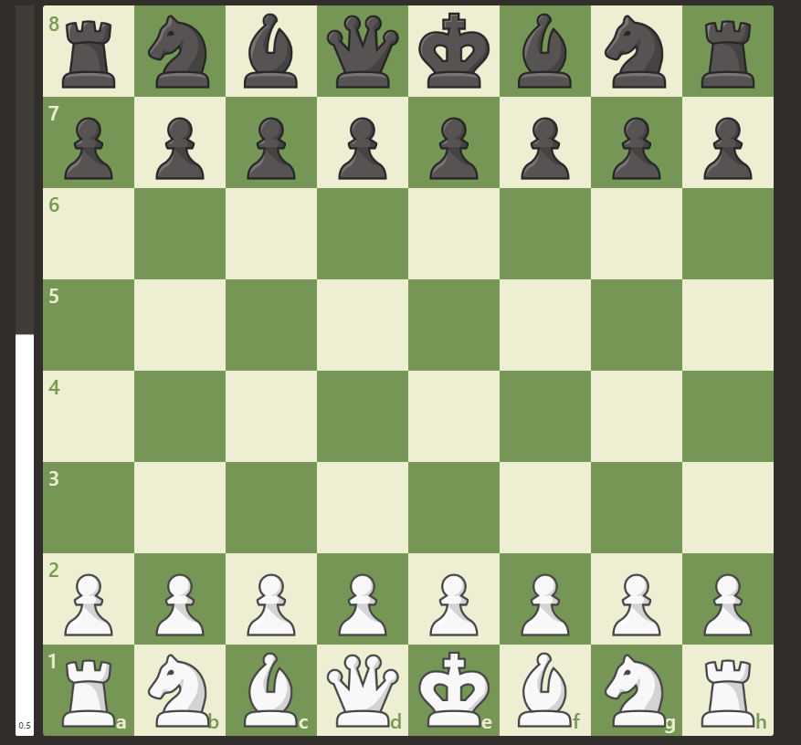
Dataset
Retrieved from Kaggle.com
10,000 High Elo Chess Games with Centipawn Loss
Centipawn Loss is the number of hundredths of a pawn by which a player deviated from the most accurate move calculated by a computer.
Way to measure advantage without a player having to lose a piece.
Why did I choose this dataset?
Recently started learning/playing chess
Have spectated matches featured in this dataset

Slide 3
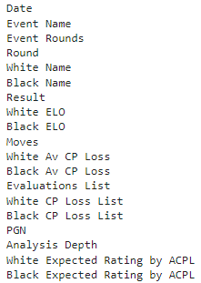
Variables
Dependent Variable
Result
Black Win
Draw
White Win
Independent Variables
18 Unique Features

Slide 4
Research Questions
I want to analyze if centipawn loss has an impact on the result of a high Elo chess match.
If not centipawn loss, I want analyze what features have an impact.
Is the result based on the Elo of the players?
Is the result based on the piece color of the players?
Is the result based on the number of moves in the match?
I want to analyze the overall effectiveness of predicting the result based on the combination of features with the highest importance.

Slide 5

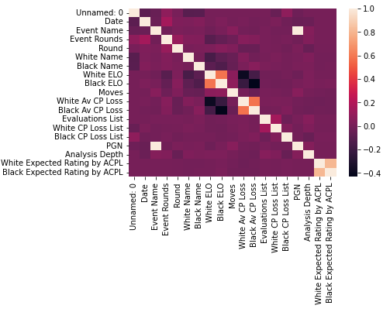
Preprocessing
Imported Dataset
Found Null Values
Imputed (Replaced) Null Values
dtype == object replaced using mode
dtype != object replaced using mean
Converted strings to float
Used Label Encoder
Created a Heatmap

Slide 6
Training Model
X = All Features excluding ‘Result’
Y = ‘Result’
Split
20% Test
80% Train

Slide 7
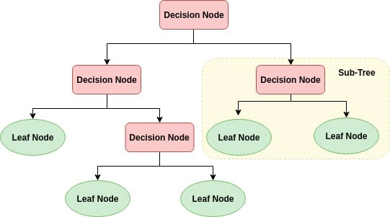
Algorithm
Supervised Learning
Result is the Target Variable
Multi-class Classification
Result has 3 possibilities
Black Win
Draw
White Win
Decision Tree Classifier

Slide 8

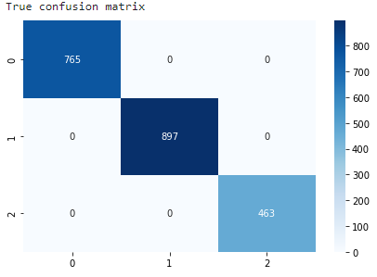
Decision Tree Classifier
ratio tp / (tp + fp)
ratio tp / (tp + fp)
Prioritized Accuracy
max_depth = 9
Precision Score of 96%
Ratio of tp / (tp / fp)
Recall Score of 96%
Ratio of tp / (tp / fn)
F1-Score of 96%
Harmonic mean of precision and recall
Accuracy Score of 95%

Slide 9
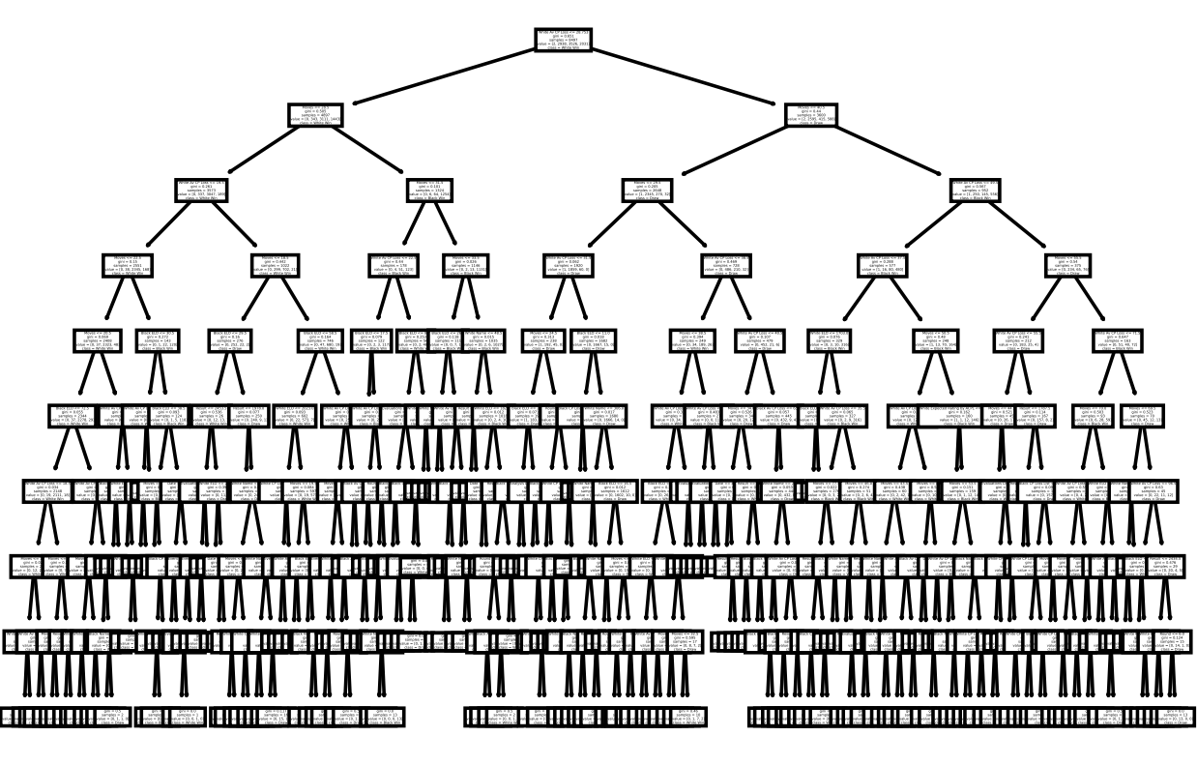

Slide 10
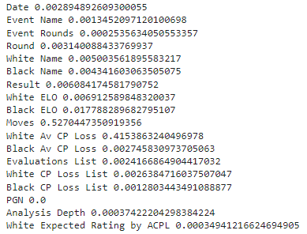
Problem
Number of nodes, branches, and leaves make it impossible to evaluate
Too high of accuracy
95% is Unrealistic
80%-90% is considered a realistic excellent model
90%-100% is usually not achievable
Most likely overfitting
Features with little to no importance are being utilized
Only Moves and White Av CP Loss significantly impact results

Slide 11
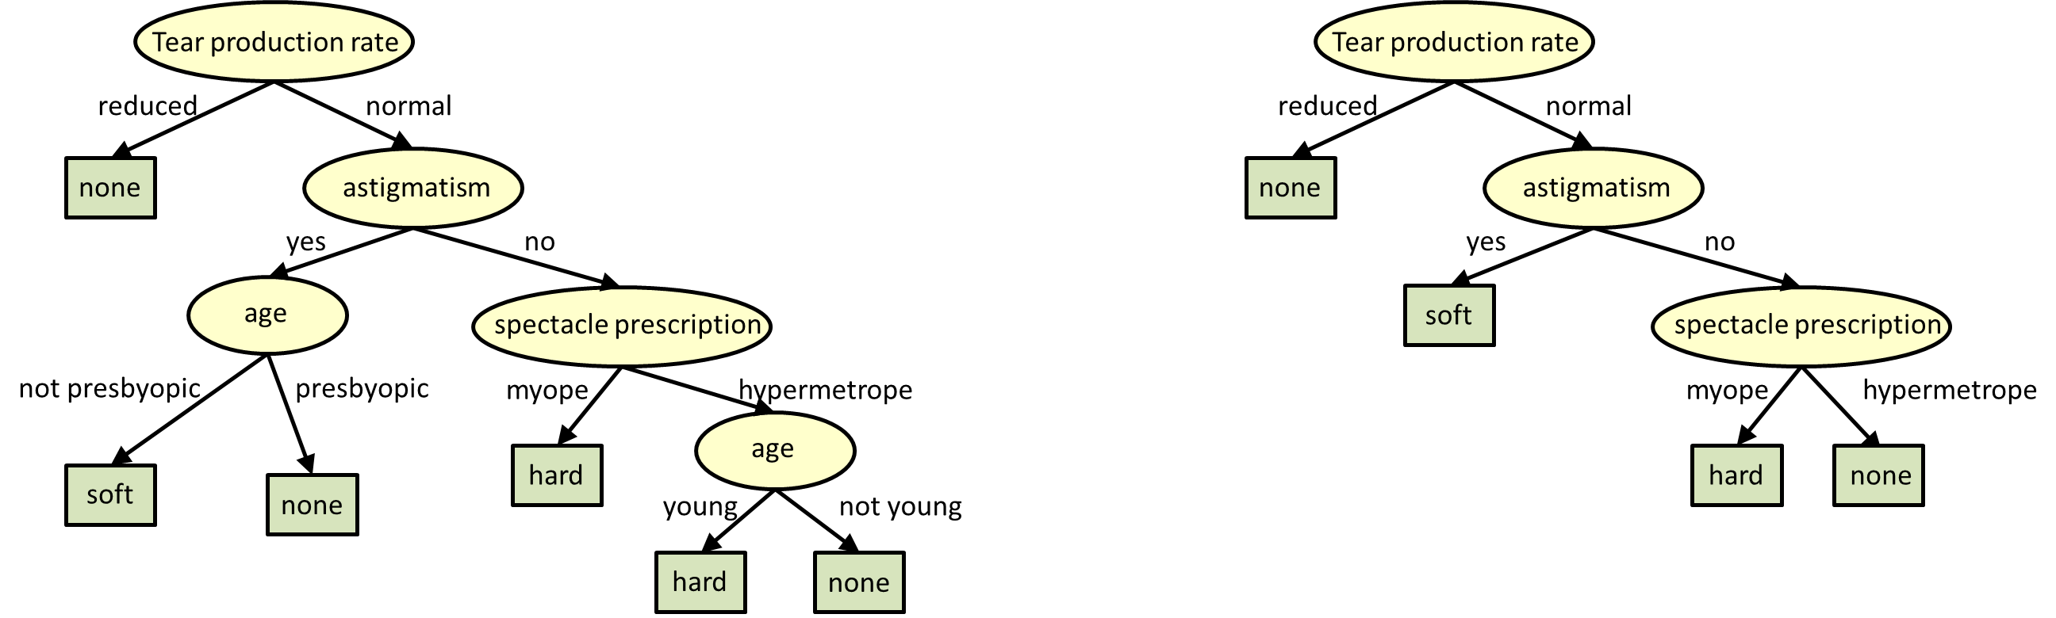
Decision Tree Classifier
Prioritized Importance
max_depth = 2
Precision Score of 84%
Ratio of tp / (tp / fp)
Recall Score of 85%
Ratio of tp / (tp / fn)
F1-Score of 84%
Harmonic mean of precision and recall
Accuracy Score of 85%

Slide 12
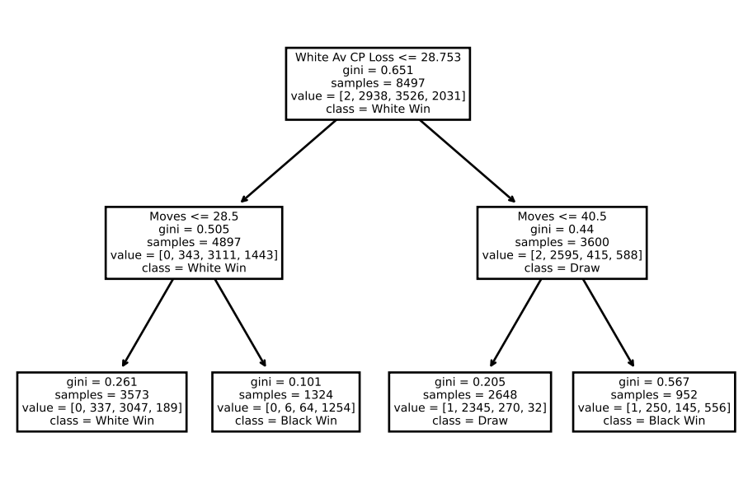

Slide 13

Conclusion
I want to analyze if centipawn loss has an impact on the result of a high Elo chess match.
Yes, White Average Centipawn Loss has the second largest impact on the result based on the analytical model tested.
If not centipawn loss, what features do have an impact on the result of the match.
The impact of most features is negligible, except for moves, which is the biggest contributing factor to the outcome of a high Elo chess match based on the analytical model. Even, the third highest importance, Black Elo, was only fractionally significant when compared to White Av CP Loss and Moves.
I want to analyze the effectiveness of predicting the result of a high Elo chess match based on the correct combination of features.
The overall effectiveness of predicting the result of a high Elo chess match based on the features with the most impact of the result is 85%.

Slide 14
Project Takeaway
Chess is a dynamic game that is not easily predicted
It is nearly impossible to predict the outcome based on factors outside the game like Elo
These factors do not account for how the player is playing during a match
However, factors that occur within the game like White Av CP Loss and Moves can be used to predict the result of the match

Slide 15
Process Takeaway
Interesting and Intriguing
Gave insight into machine learning
Related classroom concepts to real world
Further built programming foundation

Slide 16

Questions?

